Slide 1
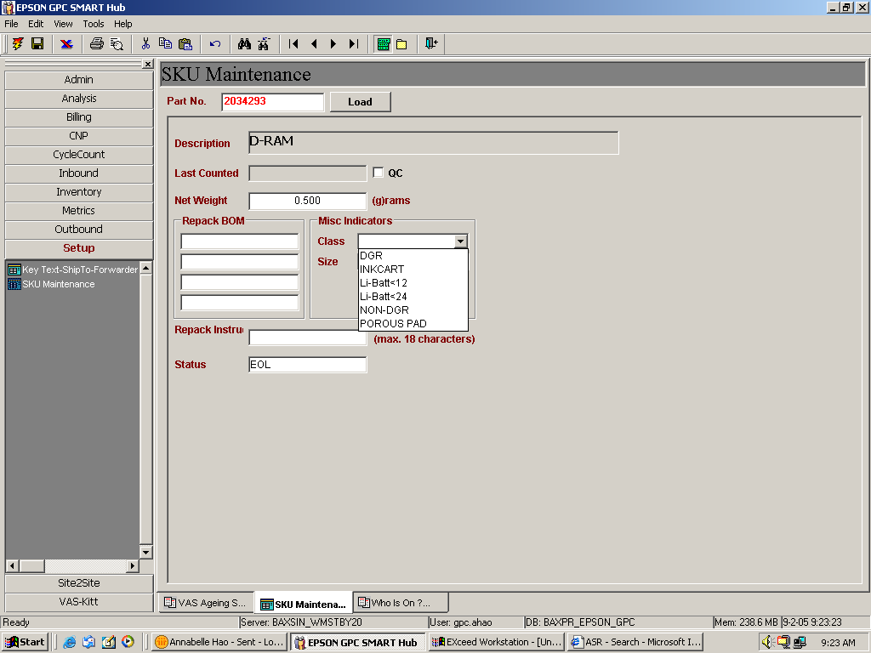
Pls add wording “DRAM” here

Slide 2
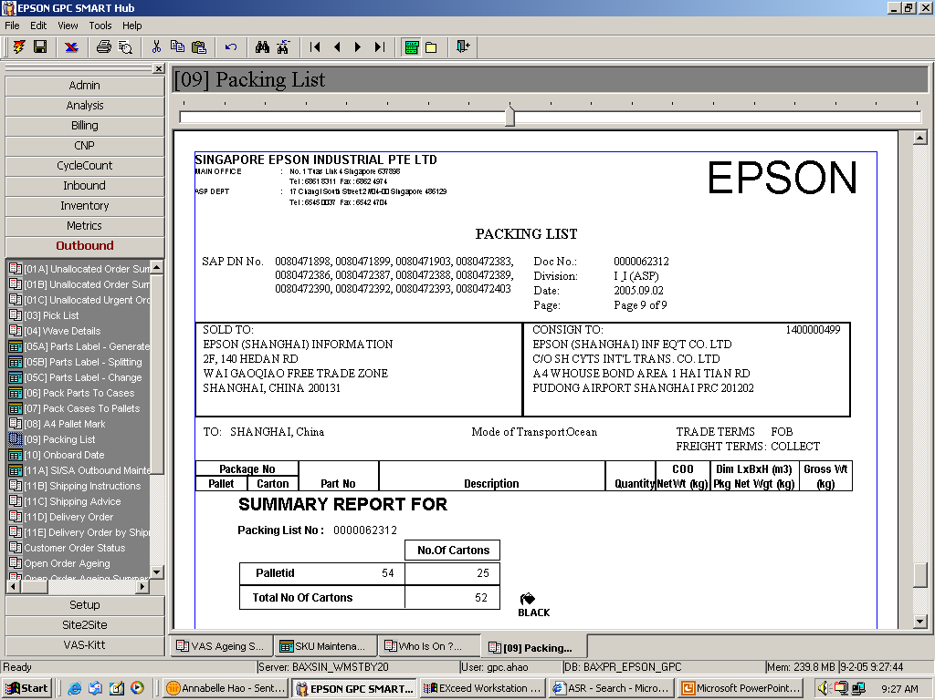
Pls flag wording “DRAM” (as logo) here

